Slide 1


EMC Underground: MetroLabs
MetroLabs

Slide 2
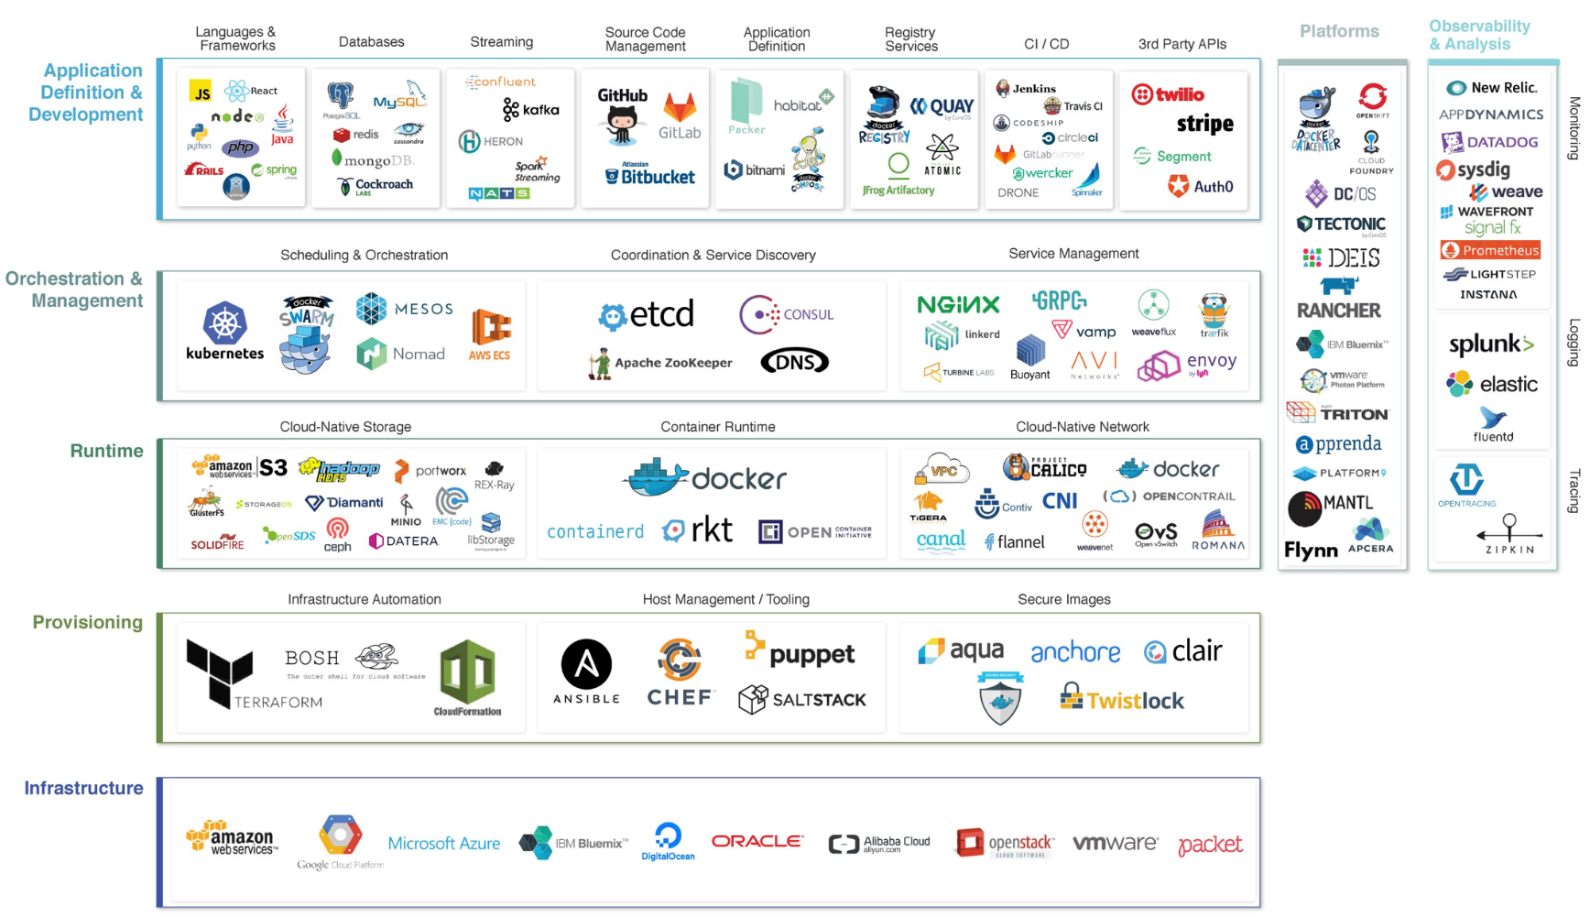

THE CLOUD NATIVE LANDSCAPE
*From Cloud Native Computing Foundation (CNCF)

Slide 3


I don’t know?

Slide 4

What is MetroLabs?
NY/NJ Based Group
Goal is to work on real world projects to help us become more comfortable in new technologies
Why are we doing this?
To gain hands on experience with the latest technologies and trends
To get people engaged in their own learning
To accelerate the rate of content absorption
To explore different ways to learn
To have fun while learning
To explore the processes as well as the technologies

Slide 5

MetroLabs 2.0 Revisions
How we are different than last year:
Project focused vs product focused (Last year)
Tie in where products fit inside the Development Lifecycle.
Curriculum based learning where each session builds on the lessons learned in the past session.
Heavily influence from the Cloud Bootcamp
Better understanding of DevOps culture and processes
Make it easier for people to take part”
Regular cadence for meetings & a virtual option, slack channel etc

Slide 6

MetroLabs 2017
Plans for this year:
Each SE able to learn more about DevOps
Participate in App Development lifecycle
Monthly meetings (local or virtual)
Last Friday of every month
Starting Friday September 29th

Slide 7

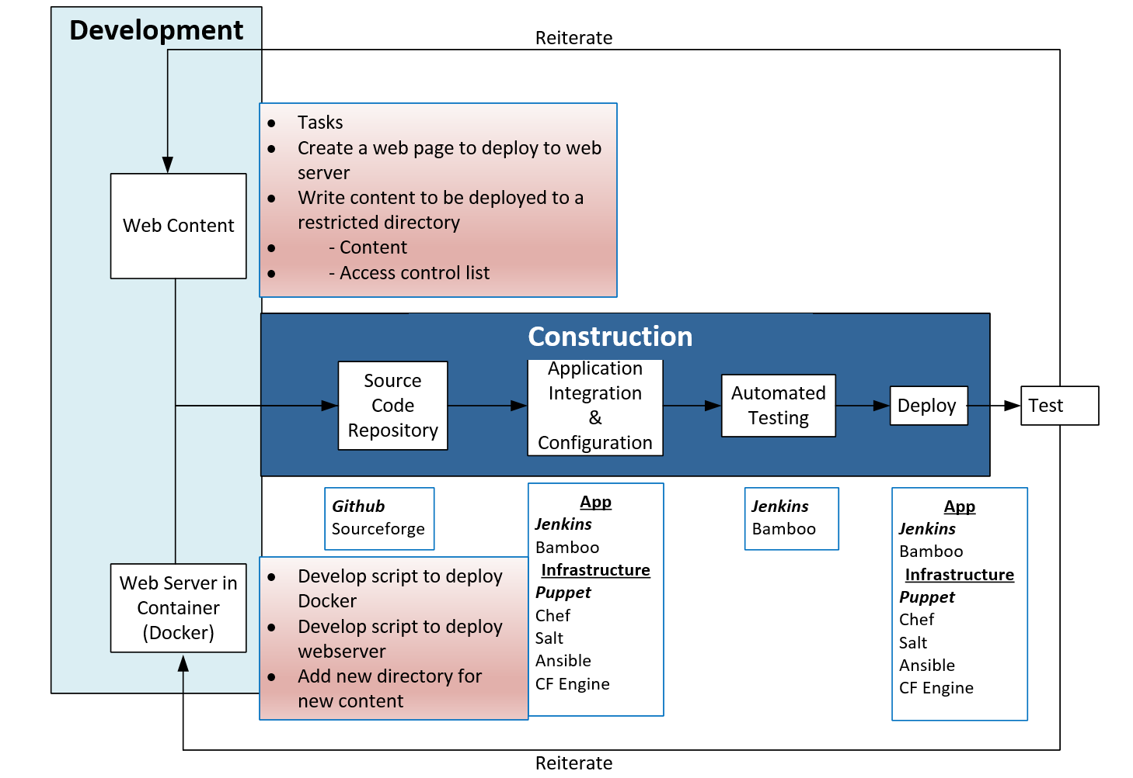

Slide 8
THE CLOUD NATIVE LANDSCAPE
*From Cloud Native Computing Foundation (CNCF)

Slide 9

MetroLabs Future Sessions
Based on feedback from the group
Possible topics:
Big Data
Splunk & Hadoop
Scheduling & Orchistration
Mesos, Kubernetes, Docker Swarm
Container Management

Slide 10

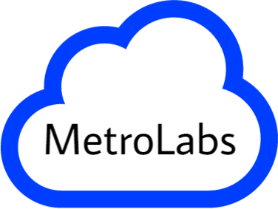
Sign up for MetroLabs
Survey Monkey
https://www.surveymonkey.com/r/MHPPYH8
Slack Channel
nynjentpresales.slack.com
Inside Dell Page
https://inside.dell.com/groups/metrolabs

Slide 12

Survey Results

Slide 13

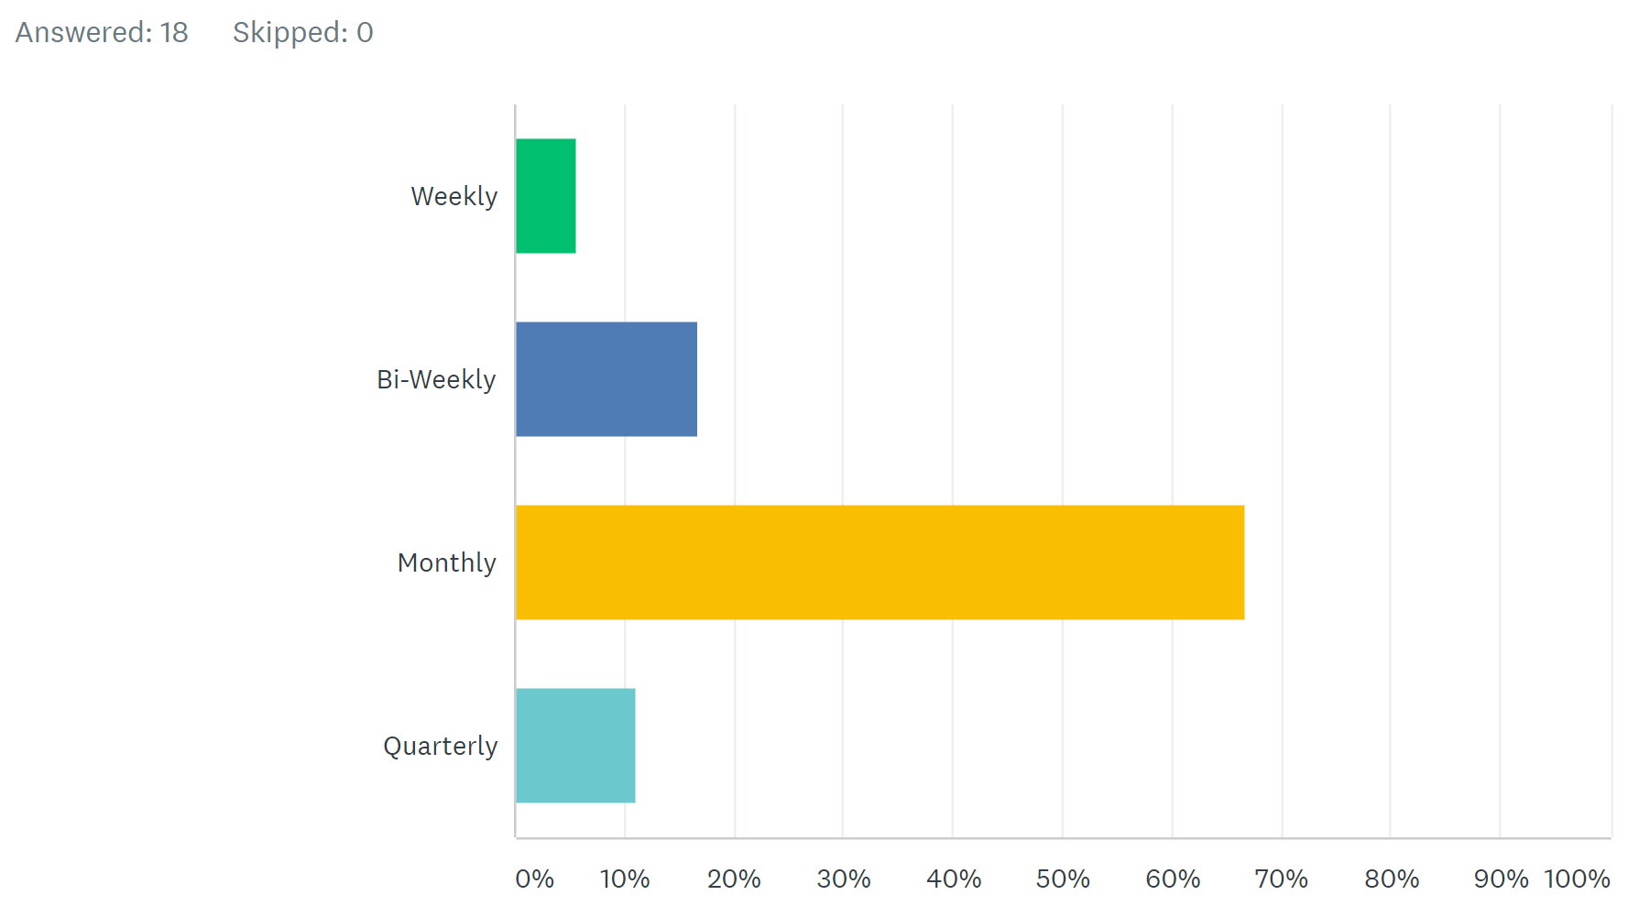
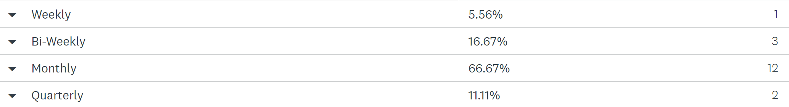
How Frequently would you like to meet up

Slide 14

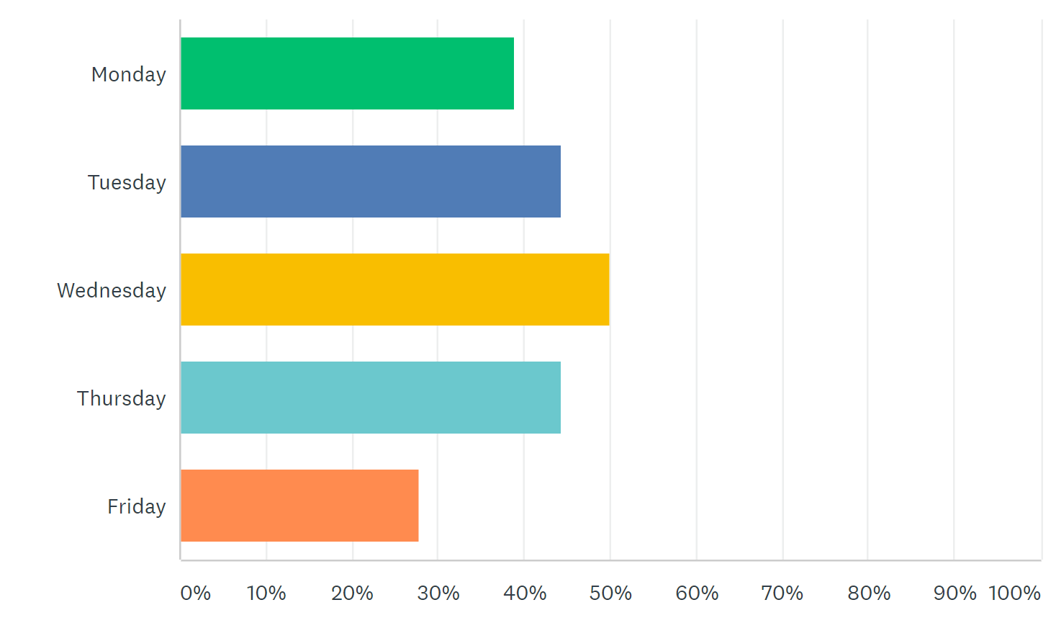
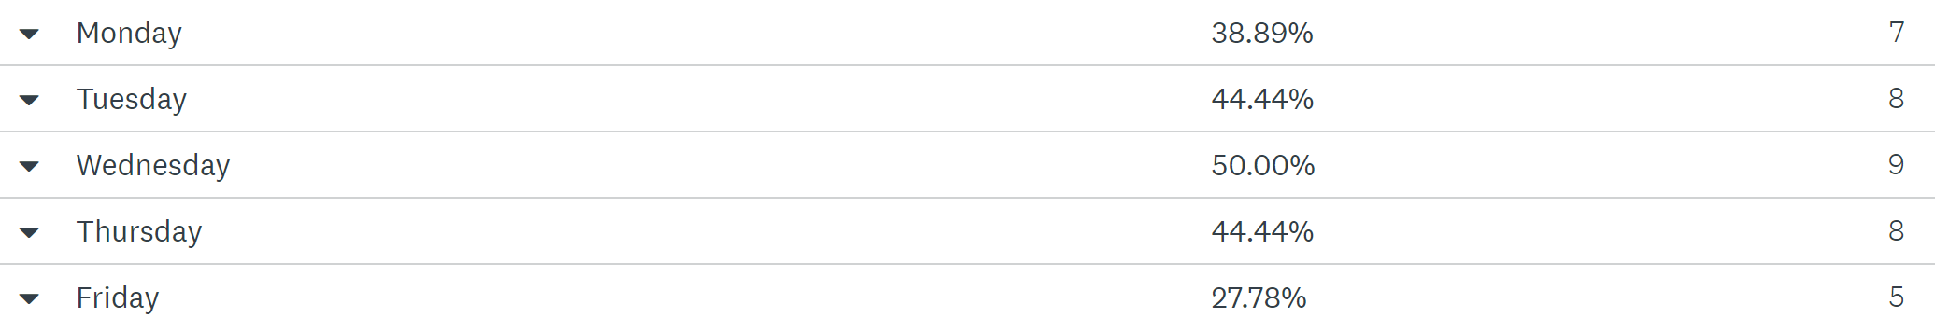
What day(s) of the week work best for these meetings?

Slide 15

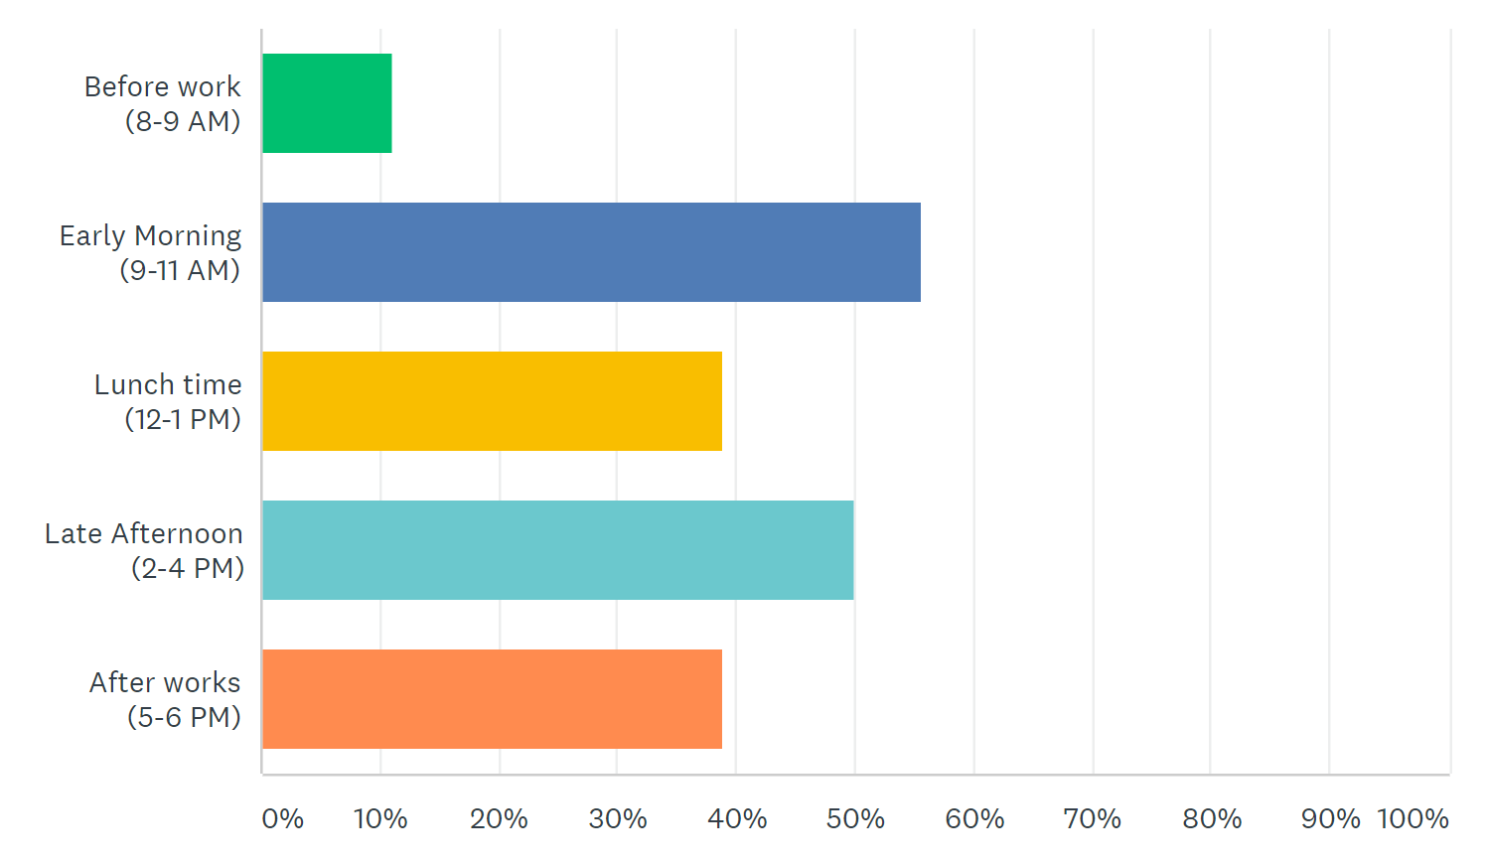
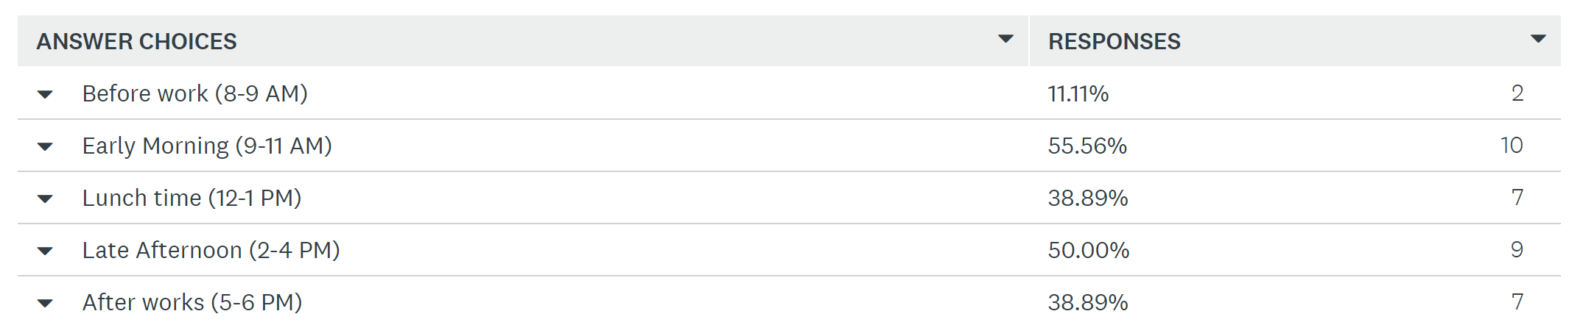
What time works best?

Slide 16

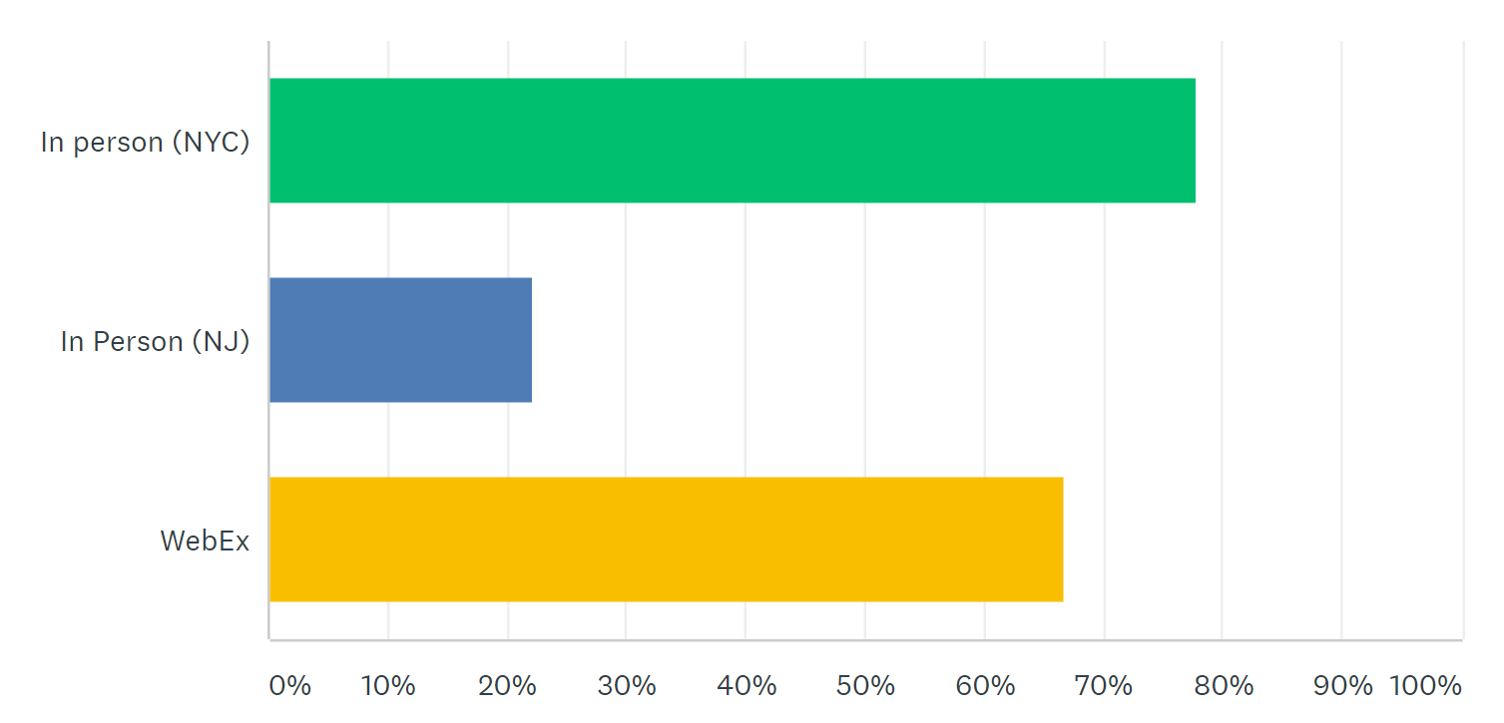
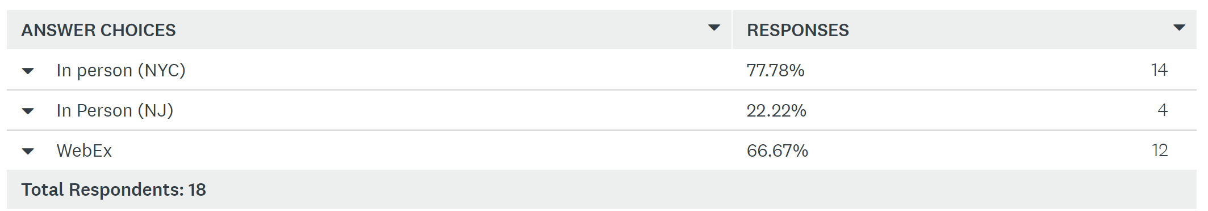
How would you like to attend?

Slide 17

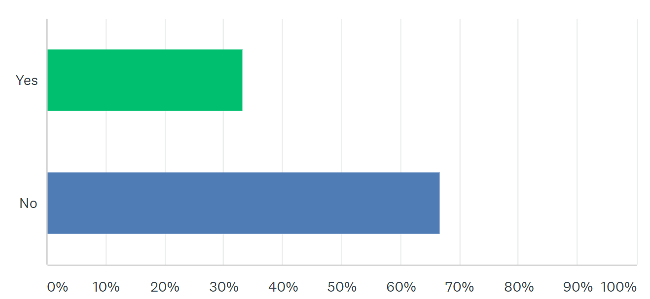
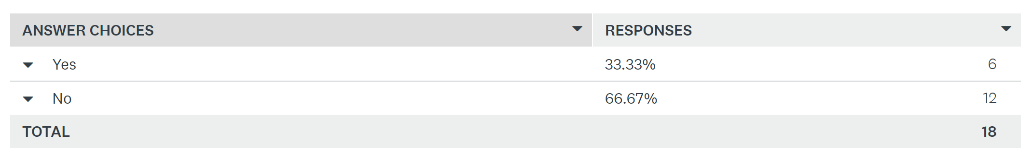
Do you have DevOps Experience?

Slide 18
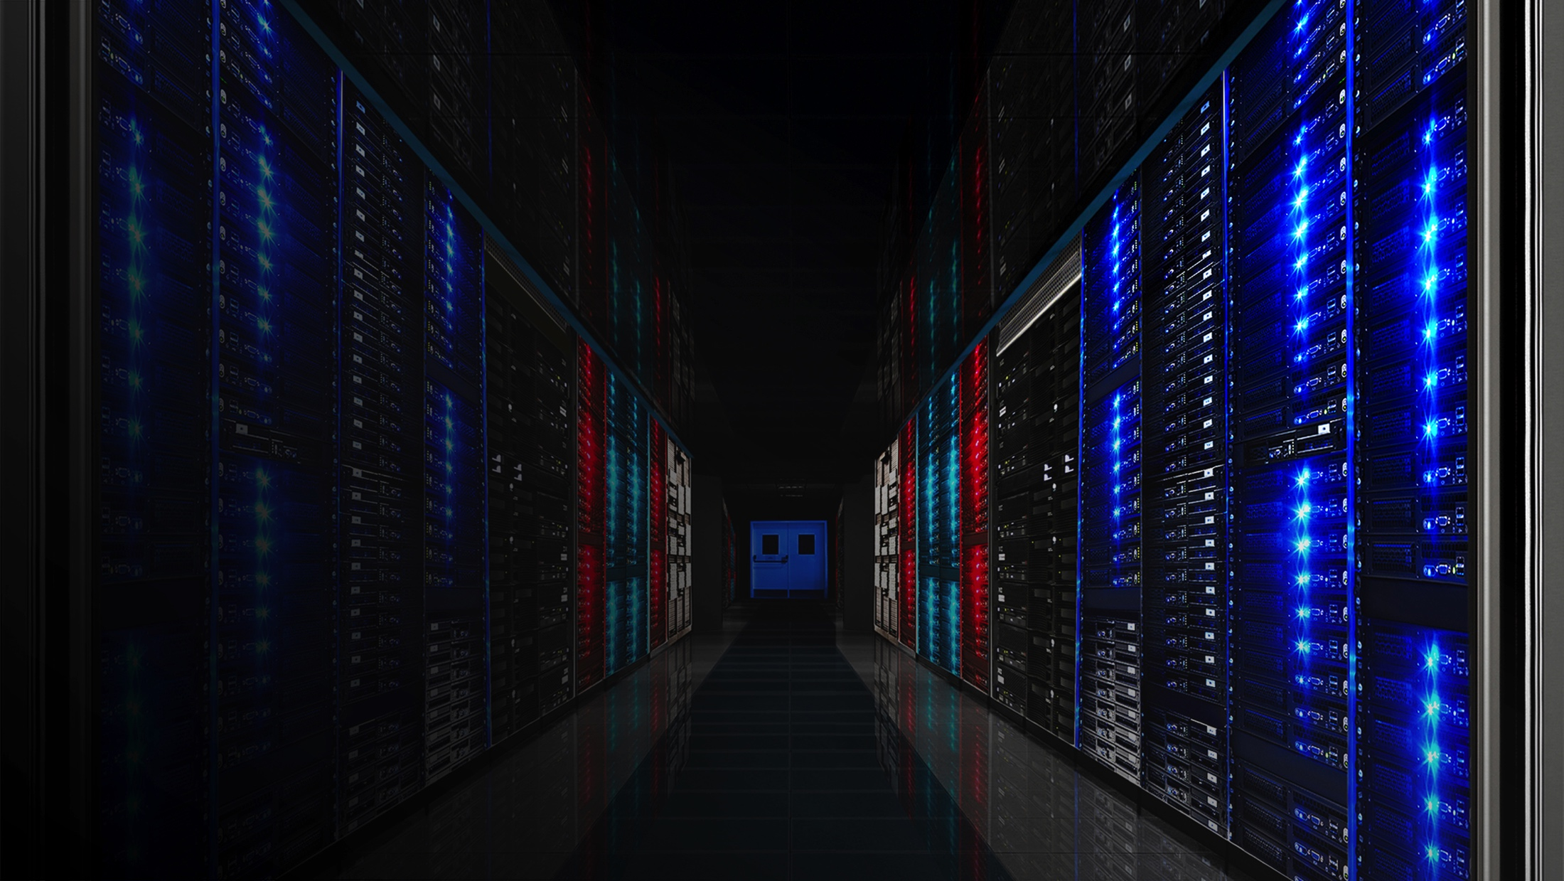
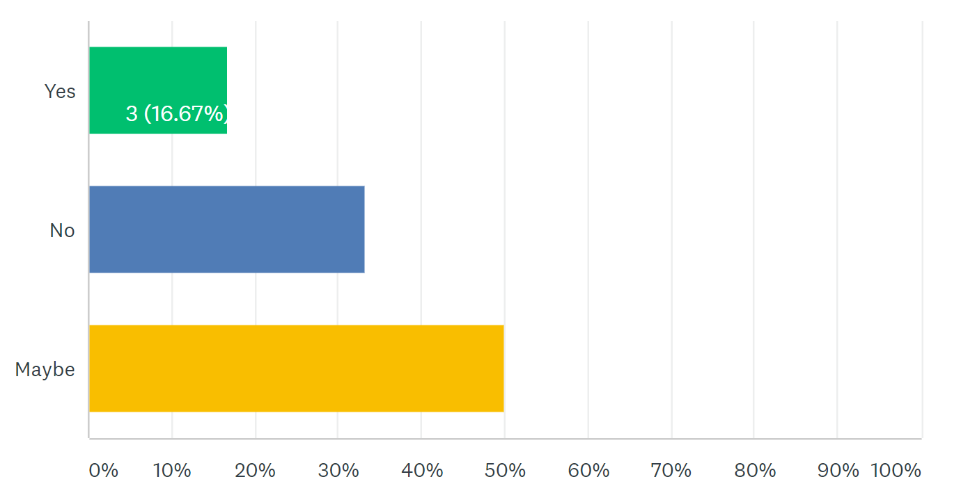
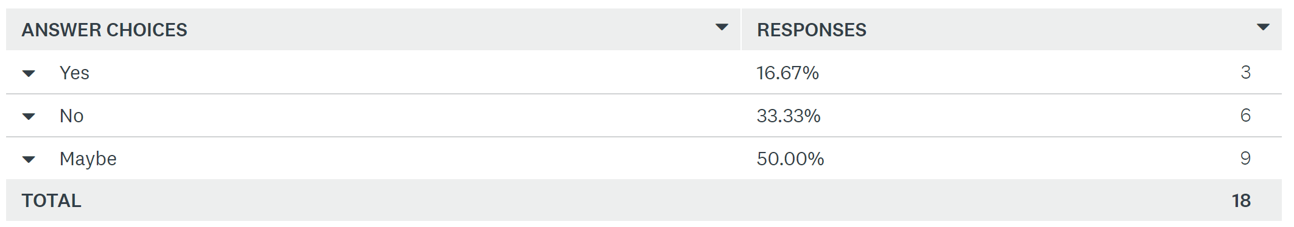
Are you interested in assisting MetroLabs?

